Slide 1

STATEC Hackathon
Pension Sustainability Analysis in Luxembourg
October 2025

Slide 2
Dependency Ratio

Slide 3
Dependency Ratio

Slide 4
Dependency Ratio

Slide 5
Our Approach
Re-engineered salaries
Contributions to the pension system
Benefits from the pension system
Discounting
Further steps: Fiscal Gap

Slide 6
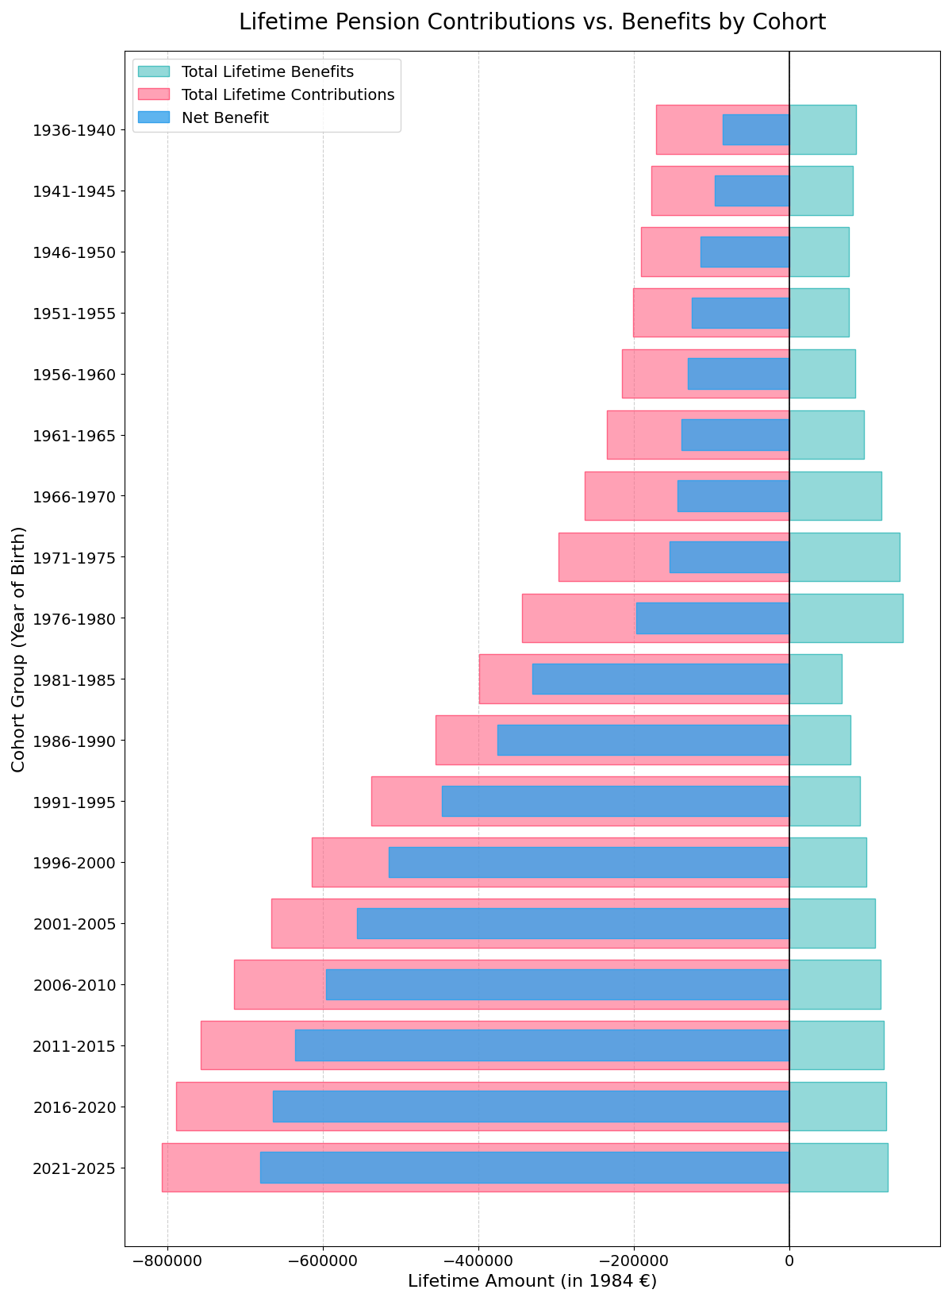
Pension System

Slide 7

Team Members
03

Slide 8



Meet the Team
Nicolas
Nikita
Nour

